Slide 1
YouTube Dataset Analysis
DAB – 16 / 90’s Group Project

Slide 2
Problem Statment & Approaches:
Top channels based on engagement.
Top category (Music, Sport, new, …).
Engagement in weekend vs. weekdays.
Categories with the fastest growth in engagement over time.
Relationship between likes & dislikes on the comments volume.
Engagement in GB YouTube trending videos is mainly driven by specific categories , while other categories show weak or stagnant interaction. This imbalance suggests limited audience diversity and declining interest in non-entertainment content.

Slide 3
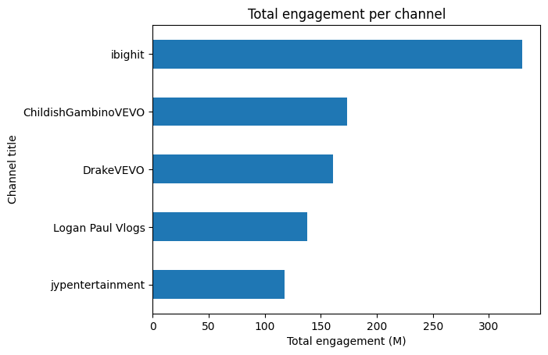

Slide 4
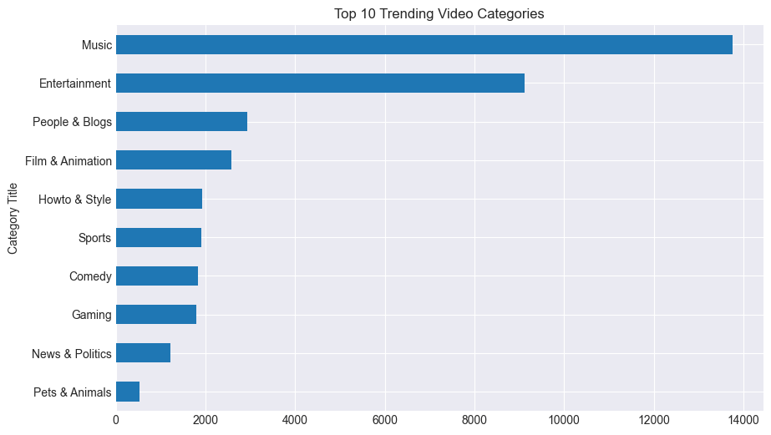

Slide 5
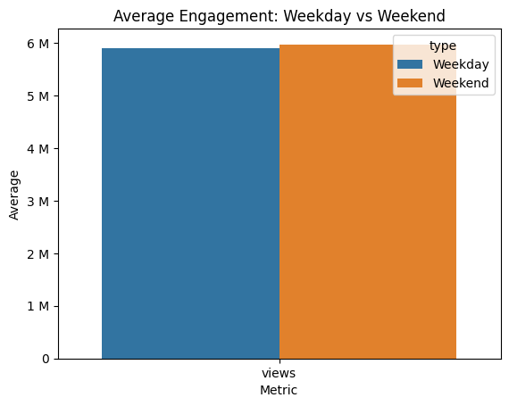

Slide 6
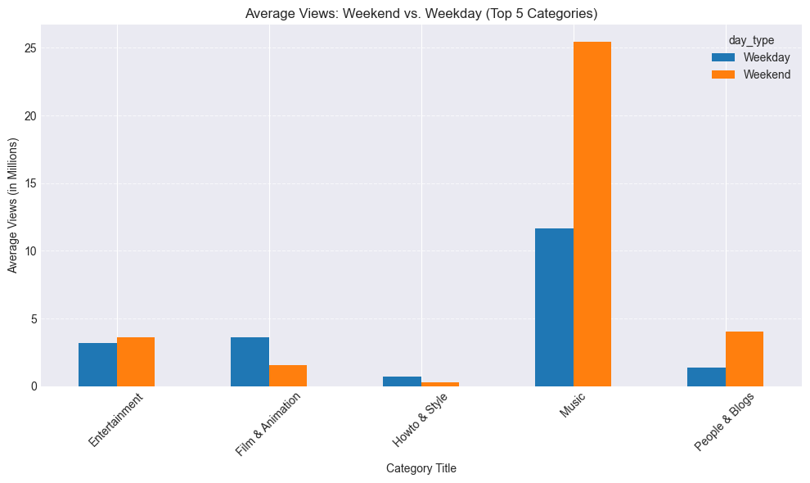

Slide 7
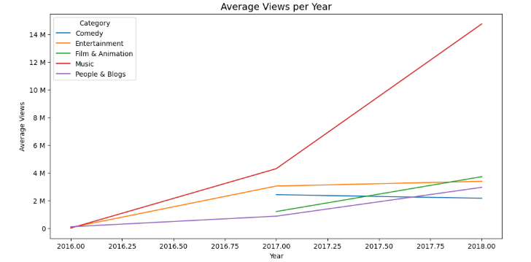

Slide 8
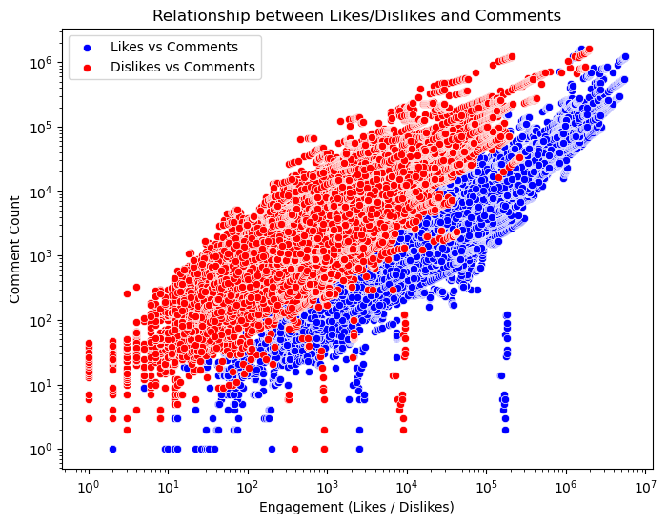
Likes
0.74
Dislikes
0.77

Slide 9
Conclusion & Recommendations
Music dominates in both views and engagement, confirming its leading role in GB’s trending content.
Weekend uploads, especially in Music and Entertainment, gain slightly higher engagement.
Blend entertainment with other genres to attract more audiences.
Use weekend spikes to launch interactive campaigns.
Likes and comments are strongly correlated, reflecting positive audience interaction.

Slide 10
Thank you for your attention

